Slide 1
SPIKING NEURAL NETWORKS FOR FAST-MOVING OBJECT DETECTION
Mario Real Enrique

Slide 2
Recap
Task: Ball tracking (x, y, R)
Two problems
In rolls ball moves slowly, so the ball is barely visible
Throws often go out of the FOV

Slide 3
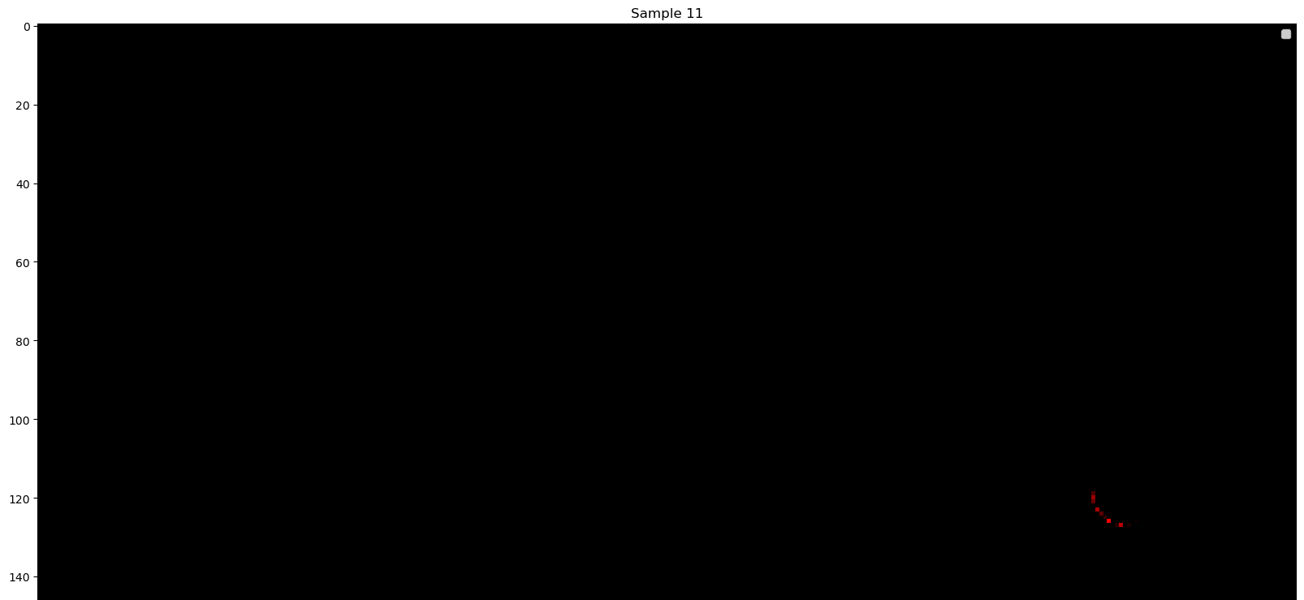
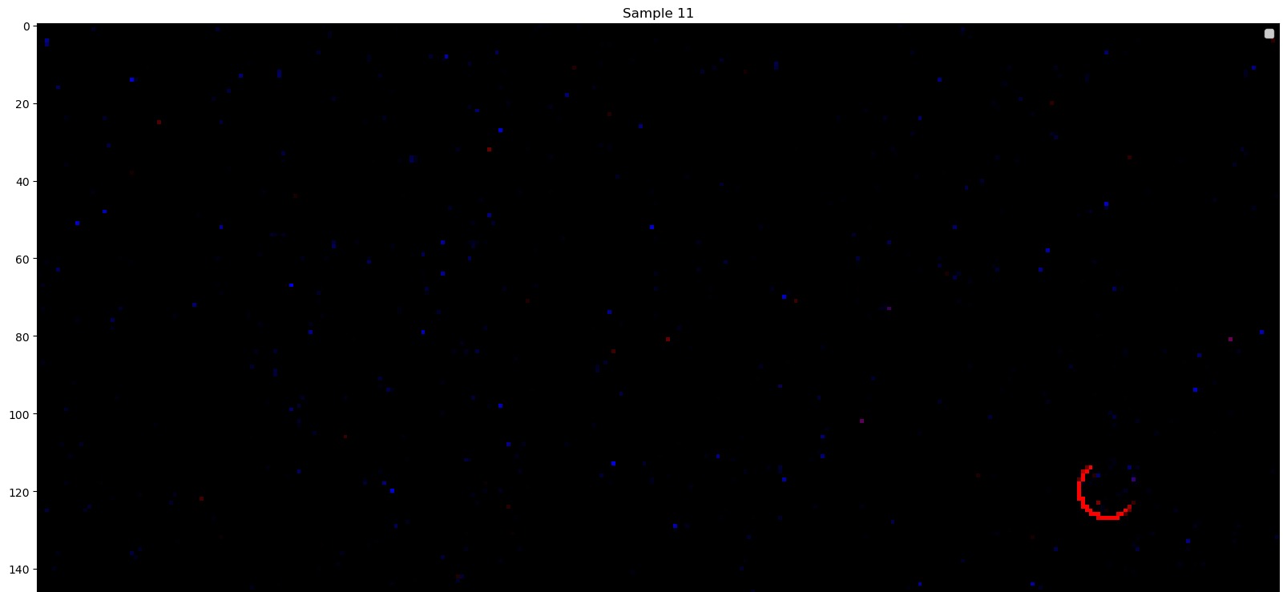
1st Problem
Problem: Rolling balls are barely visible
Solution: Change in quantization function
Before I was using interpolation
Thin figures virtually disappeared
Switched to max pool
Now all balls are visible but noise gets amplified
Doesn’t seem to matter (due to continuity)

Slide 4
2nd problem
Problem: Throws often go out of the FOV
Proposed solution: PINN loss
Issues with PINN loss
Forced to either do regression (slower)
or add a lot of bins that would only be activated when the ball goes outside the FOV (inefficient)
Need for recurrency (plenty of timesteps without seeing the ball)
New solution: Kalman Filter integration

Slide 5
Kalman Filter Integration
The idea is to treat the neural network as a sensor and feed the measurements into a Constant Acceleration KF
KF would estimate the position of the ball regardless of the noisy measurements
When the ball goes outside of the field of view, the filter switches to prediction
How does the filter know when to switch?
From the predicted values of the balls
Directly from the network

Slide 6
Confidence Net
X SFCL
X prediction
Y SFCL
Y prediction
EVENT DATA
2 channels
(+, -)
3 Layer SCNN
R SFCL
R prediction
In FOV SFCL
In FOV prediction

Slide 7
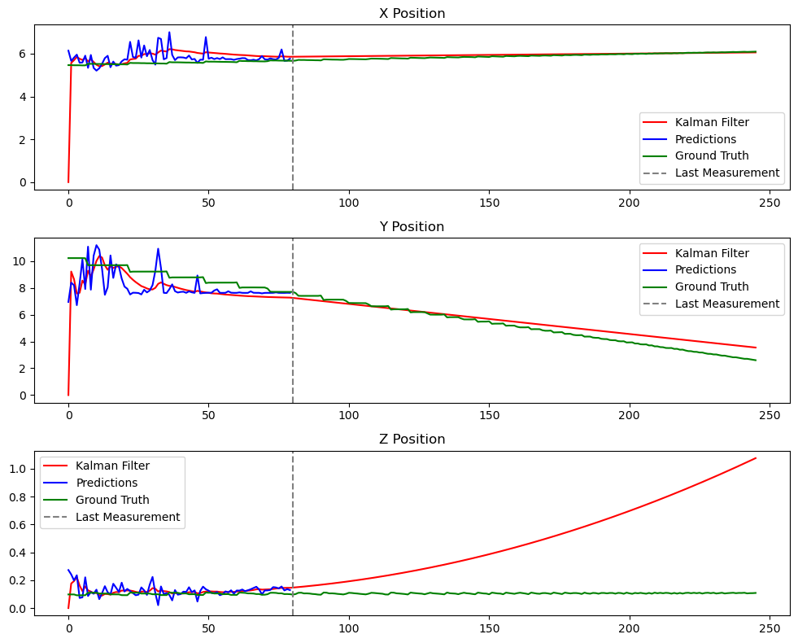
Current State
Space error | Space + Confidence error
1.9 px | ~10 px
Training updates
Learn threshold
Augmentation
Experimented with dynamically changing LR

Slide 8
Next Steps
Improve accuracy as much as possible
Improve KF so acceleration is either 9.8 or 0
Measure accuracy in 3D space
Write the report

Slide 9
Accuracy vs latency
Accuracy vs type of traj.
Accuracy vs distance
Accuracy vs time looking at the ball fixed 1s after I stop looking and measuring there
Signal to noise ratio (with a mask on the ball)

